Slide 1

Power BI Desktop

Slide 2

OVERVIEW
Power BI Desktop
OrderQuantity
Revenue
Revenue
154.57M
Order Quantity
68K
Profit
143.13M
Total Cost
11.44M
Average UnitPrice
2.28K
▼ -99.96%
MoM
|
▲ 46.26%
YoY
92.60%
Profit Margin
▲ 1.25% ▲ 45.76%
|
MoM
YoY
Monthly Trend
Wholesale
53.64%
2017 2018 2019
6M
5M
2017
2018
2019
27,605,407.00
29,555,676.50
25,805,492.20
4M
Distributor
31.41%
3M
2M
2017 | 16,356,220.90
2018 | 17,152,871.00
2019 | 15,460,598.40
Jan
Feb
Mar
Apr
May
Jun
Jul
Aug
Sep
Oct
Nov
Dec
Top Performers
Customer
Product
Region
Currency
Warehouse
Export
14.95%
Medline
4,081,485.90
Pure Group
3,821,592.90
OUR Ltd
3,676,035.40
Product 7
25,710,124.40
Product 1
25,489,299.10
Product 2
22,846,497.50
Christchurch
11,526,693.40
Hamilton
11,490,895.30
Waitakere
11,193,020.00
NZD
58,149,949.90
USD
44,650,843.50
AUD
25,905,710.80
AXW291
73,063,995.80
GUT930
36,253,693.30
NXH382
29,533,579.90
2017 | 8,618,906.80
2018 | 6,755,114.20
2019 | 7,262,853.60

Slide 3

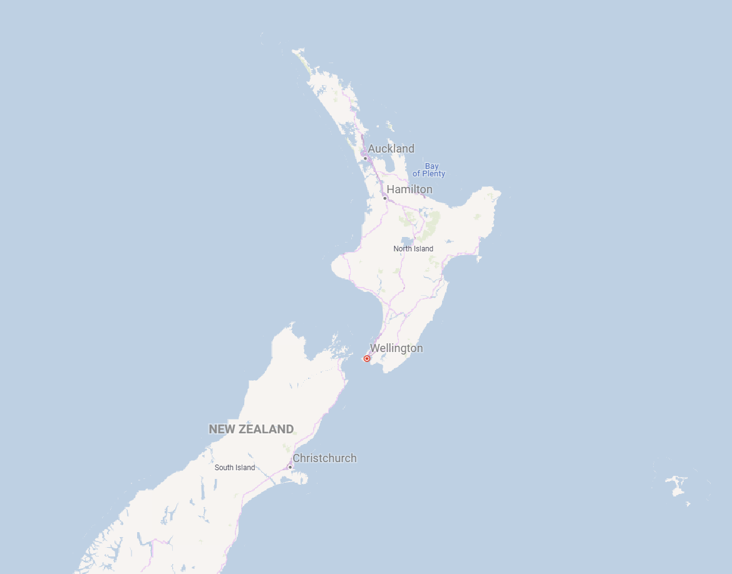


KEY MATRICS
Power BI Desktop
Top
5
Bottom
Overview
Revenue
OrderQuantity
Revenue by Customers
Top 10 Cities
Revenue & Profit by Product
Total Profit
Total Revenue
Medline
Christchurch
Hamilton Waitakere Manukau Napier
Auckland Palmerston North South Waikato Whangarei
North Shore
Pure Group
Customer
Revenue
Order Quantity
OUR Ltd
Eminence Corp
Apotheca Ltd
Product 7
Product 1 Product 2 Product 11
Revenue & Profit by Channel
Total Profit
Product 5
Region
Total Revenue
Orderquantity
Revenue by Currency
NZD USD AUD EUR GBP
Total Revenue
12.73M
Revenue by Region
13.14M
58.15M
25.91M
44.65M
Wholesale
Distributor
Export
Revenue by Product and Channel
Distributor Export Wholesale
Revenue by Warehouse
73M
36M
30M
16M
Product 7
Product 1
Product 2
Product 11
Product 5
© 2024 Miiccrrossofftt Corrporrattiion
AXW291
GUT930
NXH382
FLR025

